Slide 1
Real Time Twitter Based Encyclopedia
Vikramaditya Agarwala
Krishnaditya Kancharla

Slide 2
Problem Statement
Exhaustive nature of current dictionaries and encyclopedias
Lack of current contextual description of topics or events
A need to develop an inclusive source of information about current trending topics

Slide 3
Objective
To develop a system which :
Analyses tweets in real time and identifies the current trending topics
Collects the most relevant tweets about the trending hashtags
Adds content from these tweets into the description of the hashtag

Slide 4

Architectural Overview

Slide 5
Tweet Data Ingestion Module
Takes keywords as user input and scrapes tweets in real time consisting of the specific keywords
Built on Twitter APIv2
Initiates connection with the Spark Module
Returns tweets along with relevant hashtags
Sends data to Spark for further processing

Slide 6
Spark Processing Module
Creates a dataframe using the received text data
Leverages in-built SQL functions (split, explode) to structure the data
Performs GroupBy operation to count the tweets for each trending hashtag
Sends processed information to the Dashboard

Slide 7
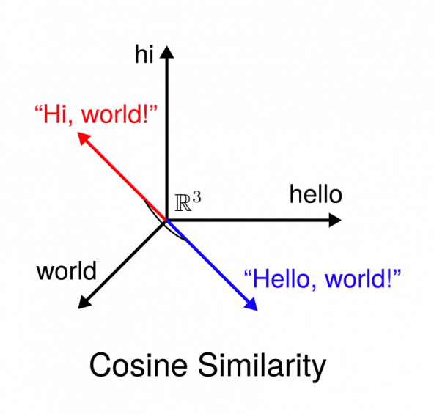
Tweet Clustering Methodologies
Cosine Similiarity and TF-IDF
- Uses TF-IDF to vectorize the tweet data
- Finds the cosine distances between tweets
- Ranks the distances for a particular tweet

Slide 8
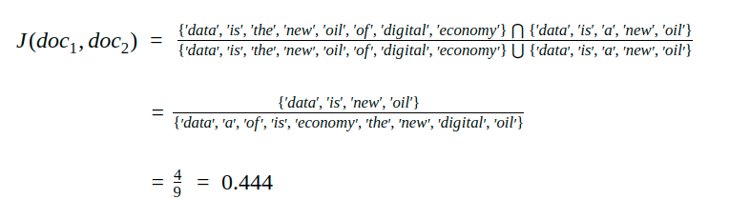
Tweet Clustering Methodologies –contd.
Jaccard Similarity and K-Means
- Finding Jaccard distance between tweets
- Using the Jaccard distance to determine new clusters
- Finding the centroids for each corresponding cluster

Slide 9
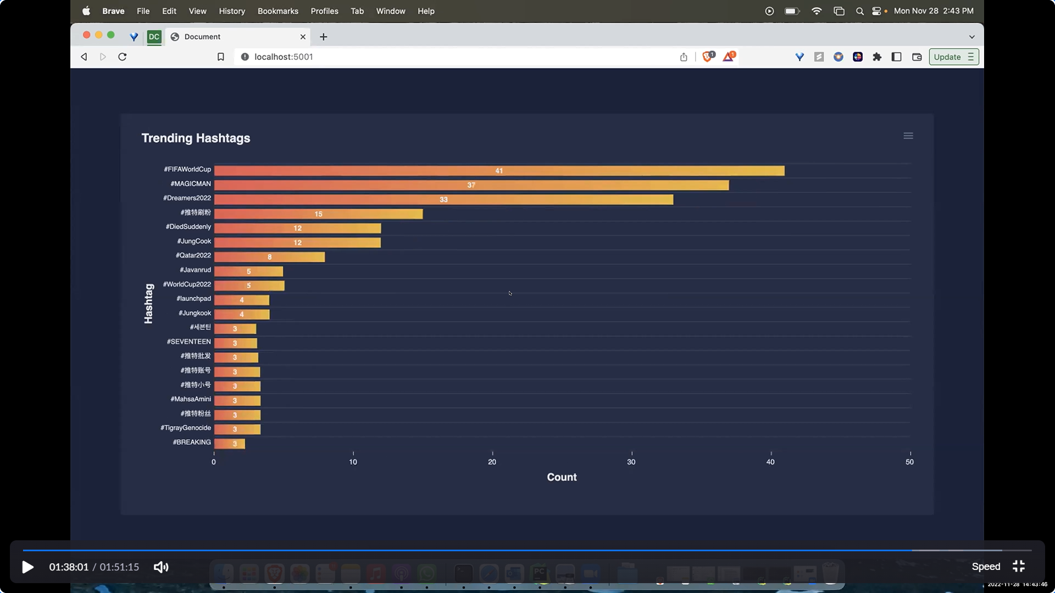
Dashboard Development
UI created with the help of Flask
Displays live visualization of the trending hashtags and respective tweet count
Separate section for the description for each of the trending hashtags

Slide 10
Results
Experiment No. | No. of Iterations | Value of K | Sum of Squared Error
1 | 2 | 3 | 11.70
2 | 4 | 4 | 11.00
3 | 3 | 5 | 10.86
4 | 3 | 6 | 11.06

Slide 11
Conclusion
We developed a live dashboard which provides a real time analysis of the trending hashtags on Twitter
The dashboard can be customized based on keywords, making it flexible for different use-cases
We implemented clustering of tweets by leveraging K-Means clustering and Jaccard Similarity Index
We also explored Cosine Similarity Methodology for tweet clustering
Learnt and used technologies like: Spark, Socket Programming, Flask, Twitter APIv2

Slide 12
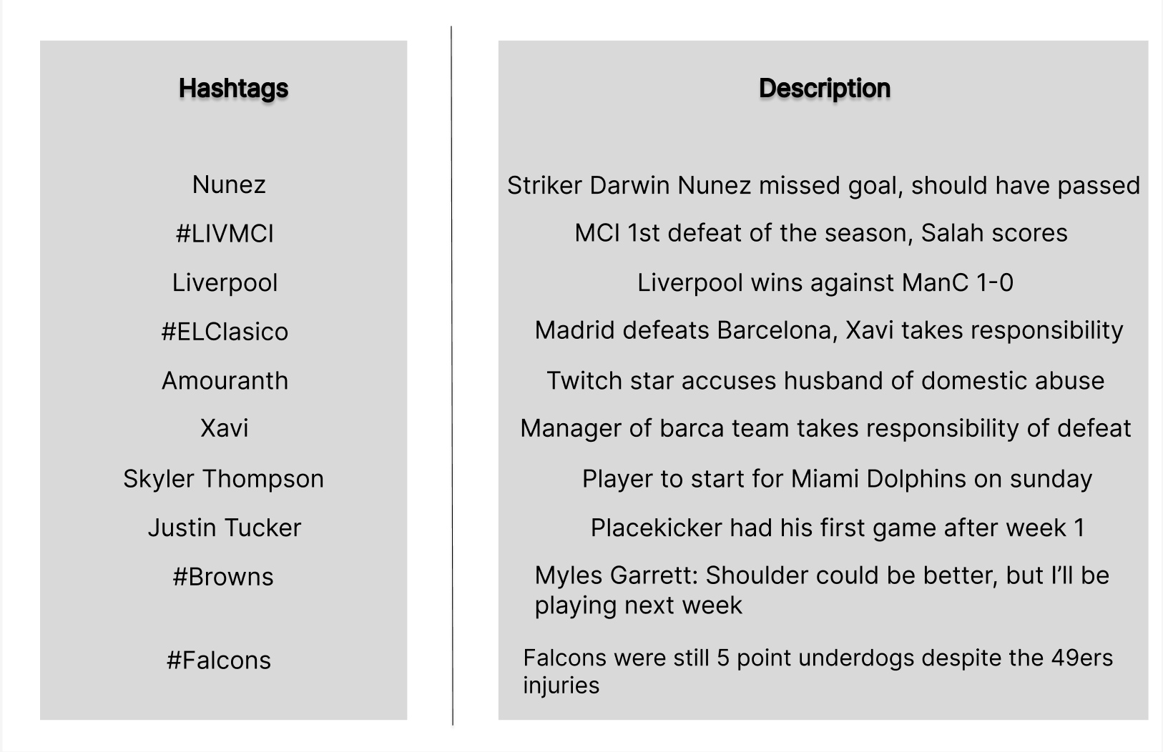
Table containing trending hashtags alongside their description (most popular tweet among cluster)

